Slide 1
FY18 Microsoft Team Front-End Training - Examination

Slide 2
Examination
Build an ecommerce web site including login page, product list page and shopping cart component.
Acceptance Criteria:
The page should be responsive SPA based on the UI mockup
The login page should be integrated with provided Token Based Authentication Web Service
The login form should perform required field validation
The product list should be retrieved from provided Restful service
The product list page should NOT be accessible until user log in
Once the product is added to cart, the shopping cart icon (Top Right) should be reflected with total account and expense
Clicking the shopping cart icon, a popup modal should be able to display with detailed product information
The shopping cart should have update items, delete item feature
A sign out functionality need to be implement, the session should be cleared once user sign out
The app should be published to Github page
Code quality and time spent

Slide 3
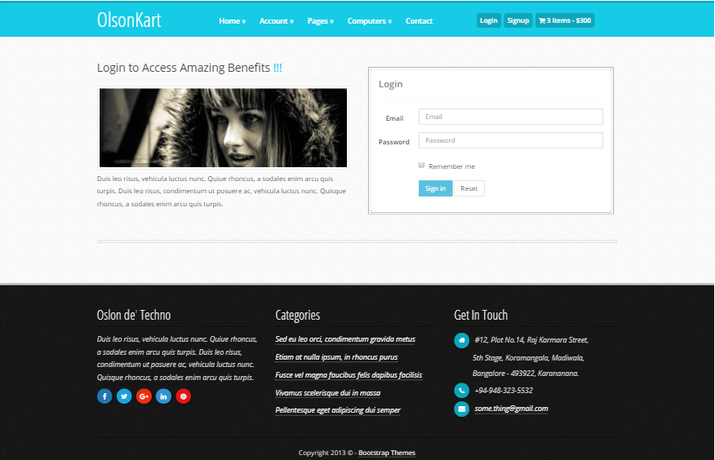
Log In Page – Desktop View

Slide 4
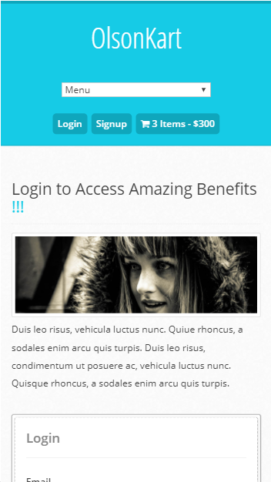
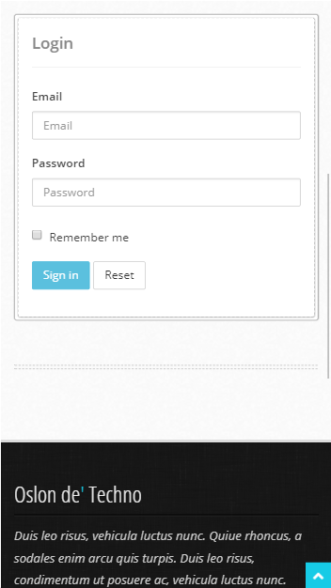
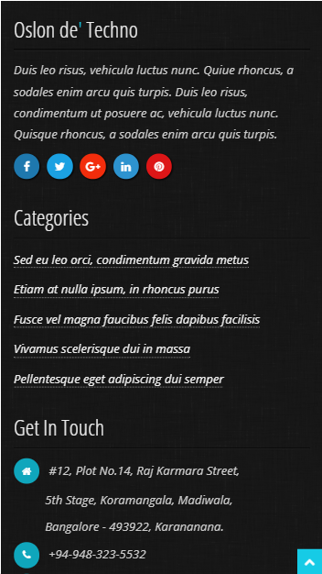
Log In Page – Mobile View

Slide 5
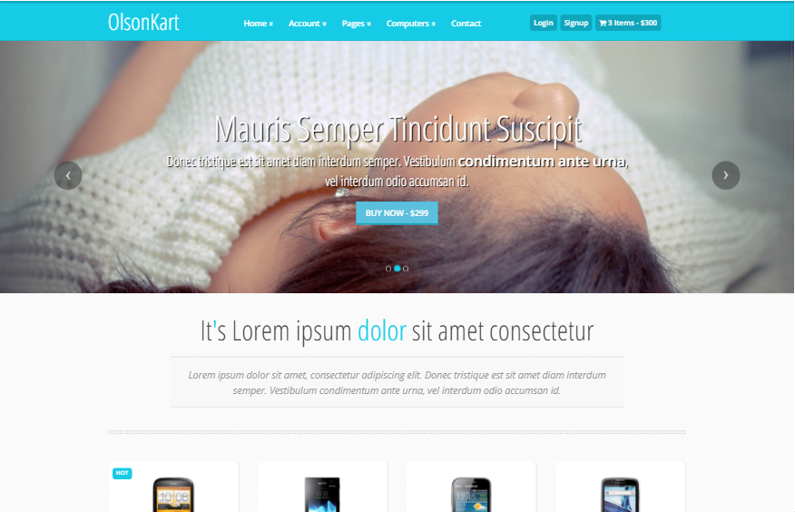
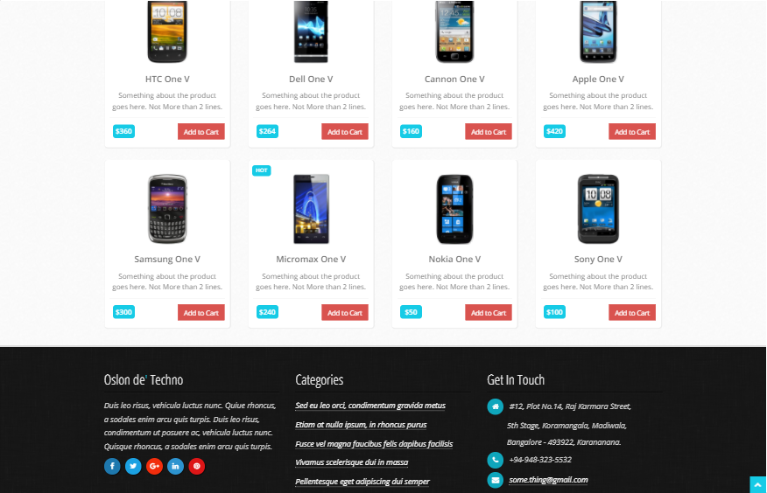
Home Page – Desktop View

Slide 6
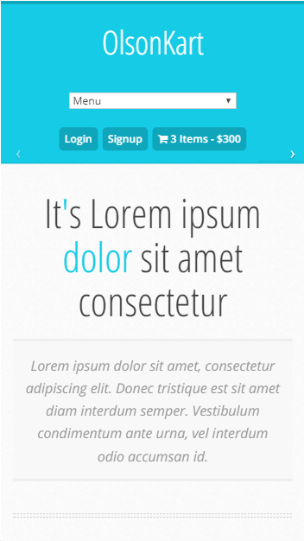
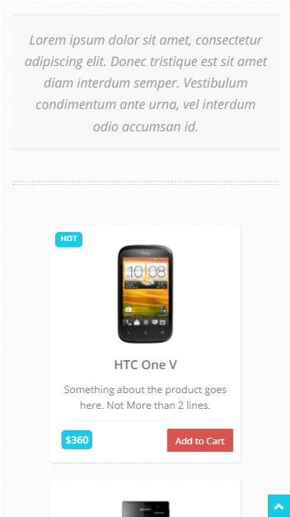
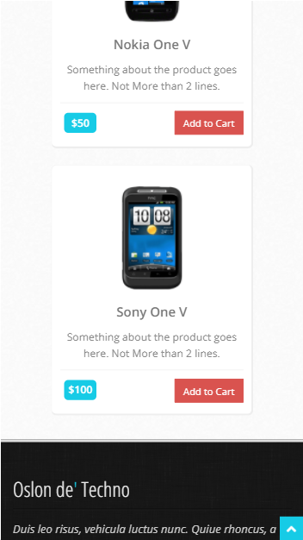
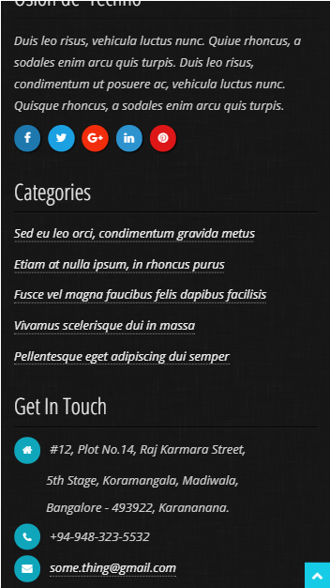
Home Page – Mobile View

Slide 7
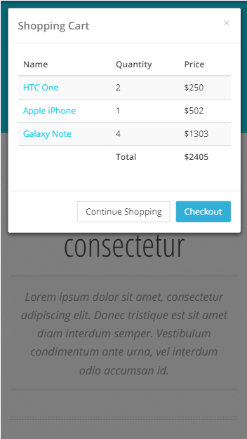
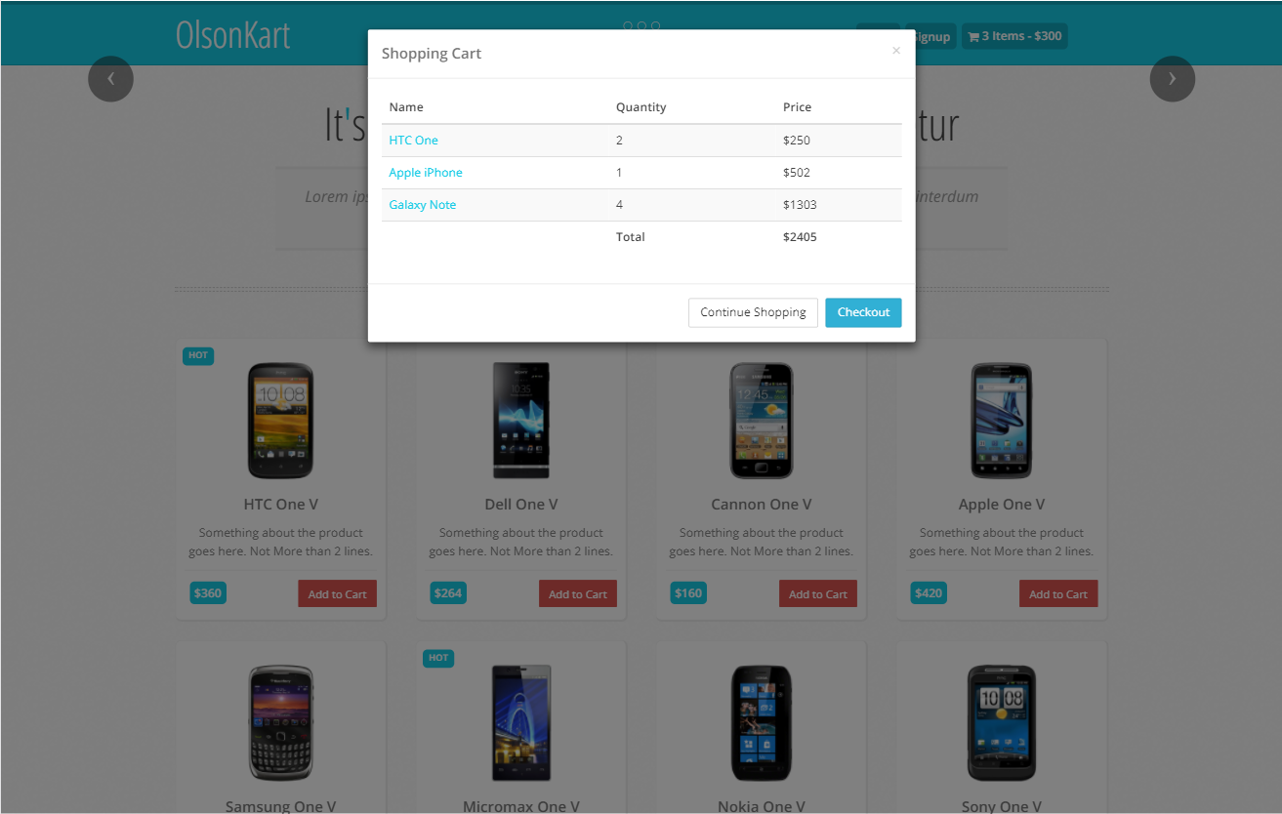
Shopping Cart

